Slide 1
Statistics 101 &
Exploratory Data Analysis (EDA)

Slide 2

Motivation of Prob & Stats
How is a good way to count number of rice seeds

Slide 3
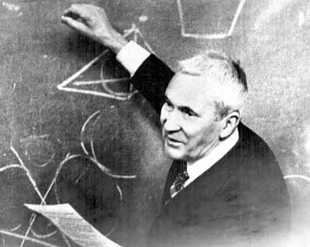

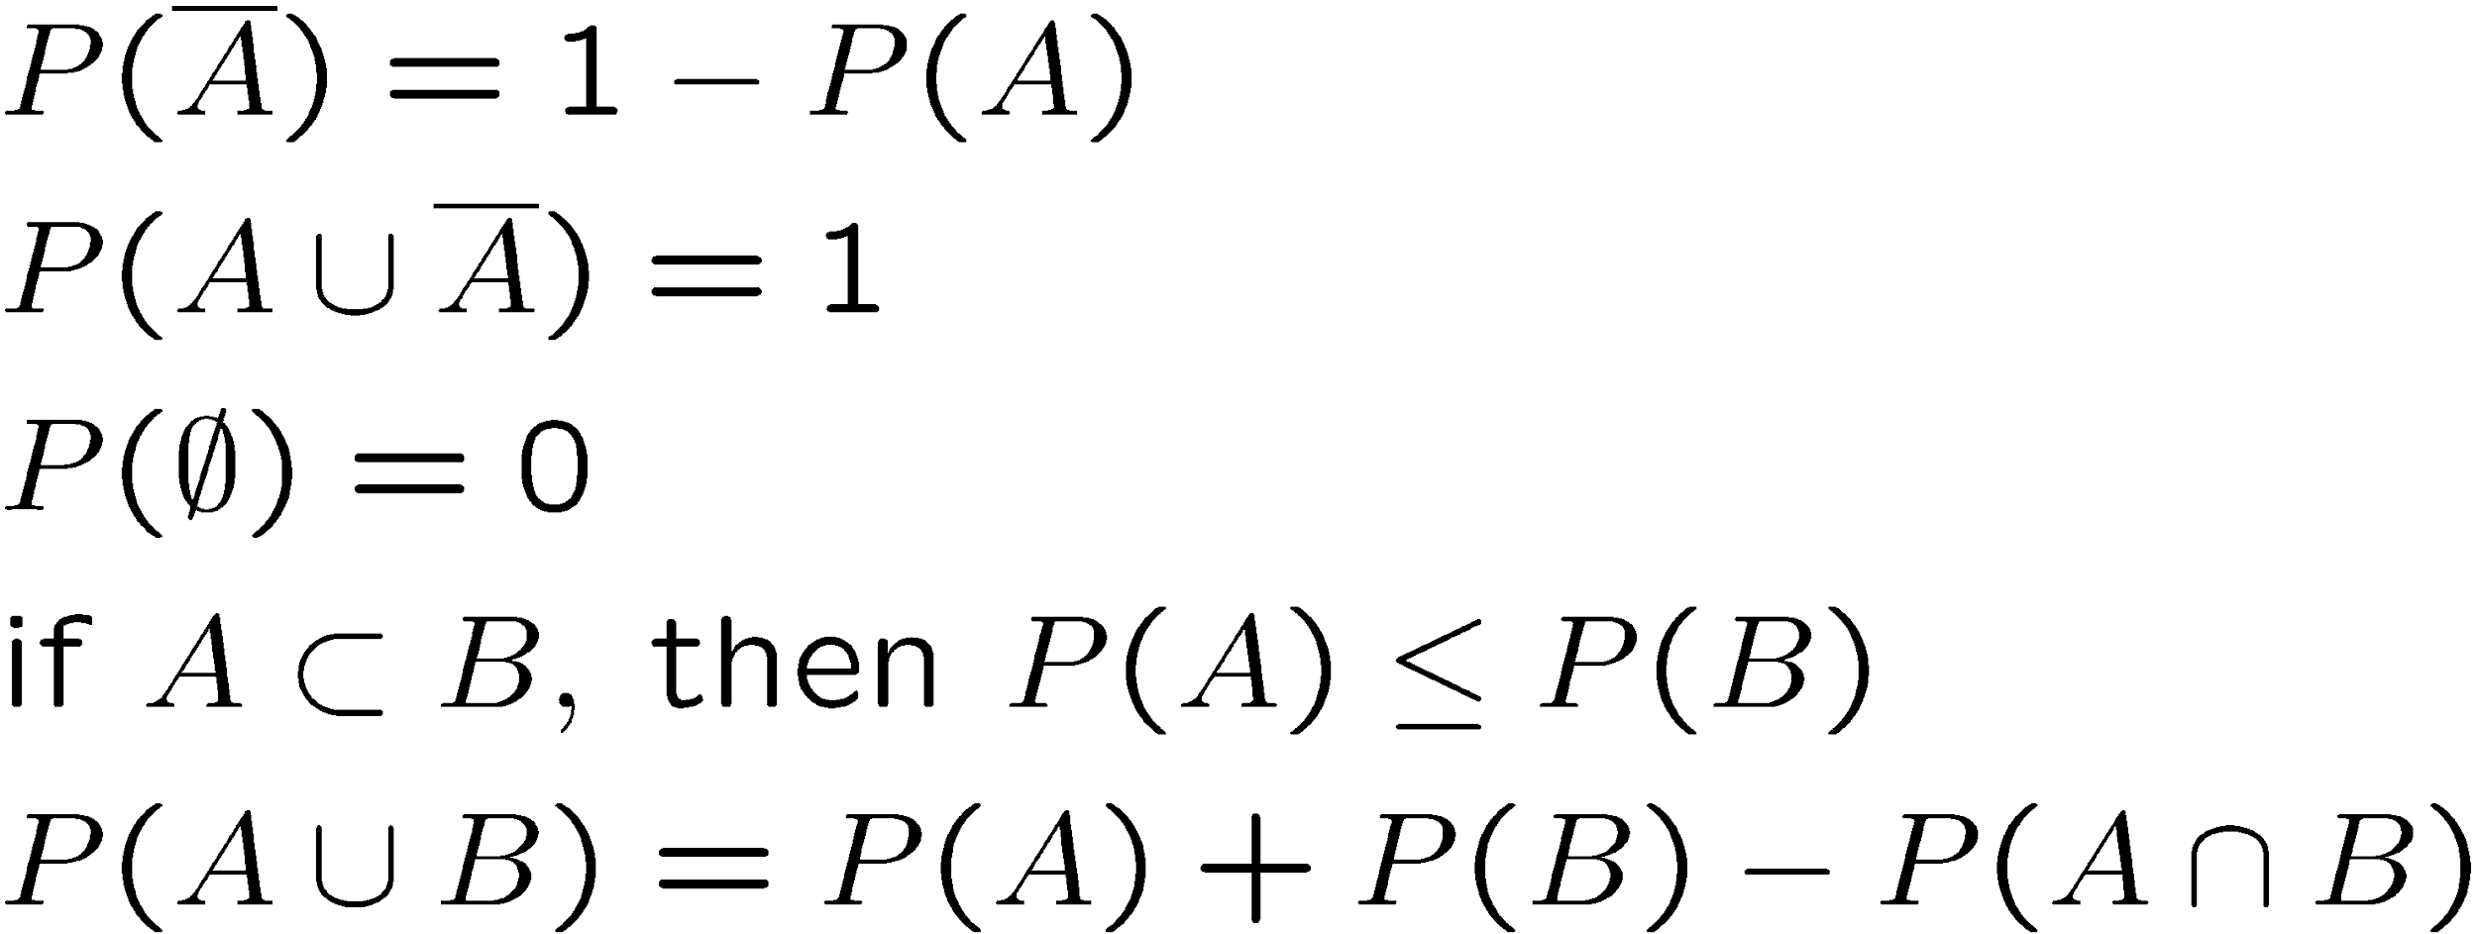
A definition of probability
Consider a set S with subsets A, B, ...
Kolmogorov
axioms (1933)
From these axioms we can derive further properties, e.g.

Slide 4
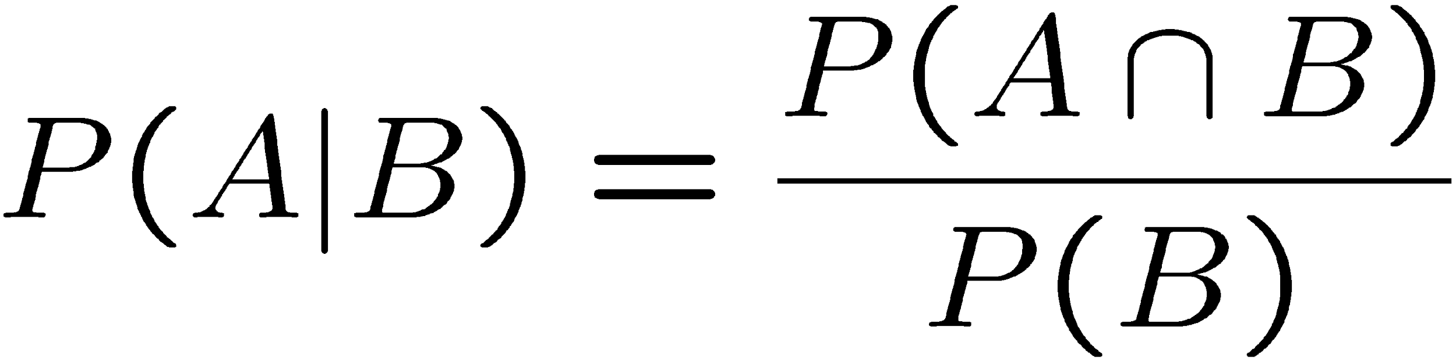
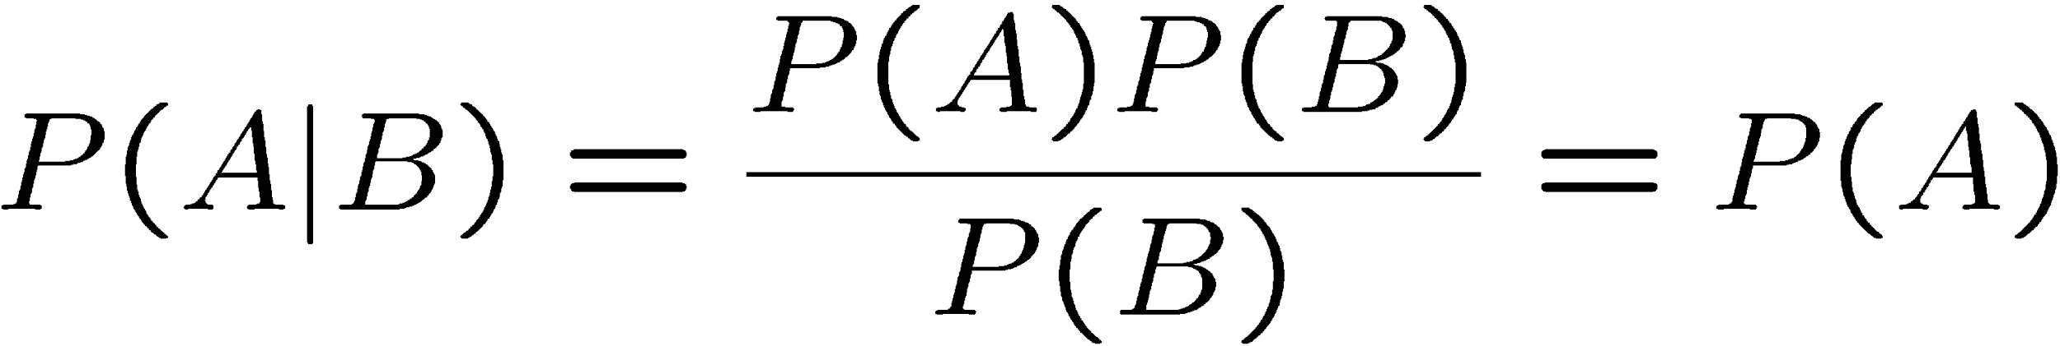

Conditional probability, independence
Also define conditional probability of A given B (with P(B) ≠ 0):
E.g. rolling dice:
Subsets A, B independent if:
If A, B independent,
N.B. do not confuse with disjoint subsets, i.e.,

Slide 5
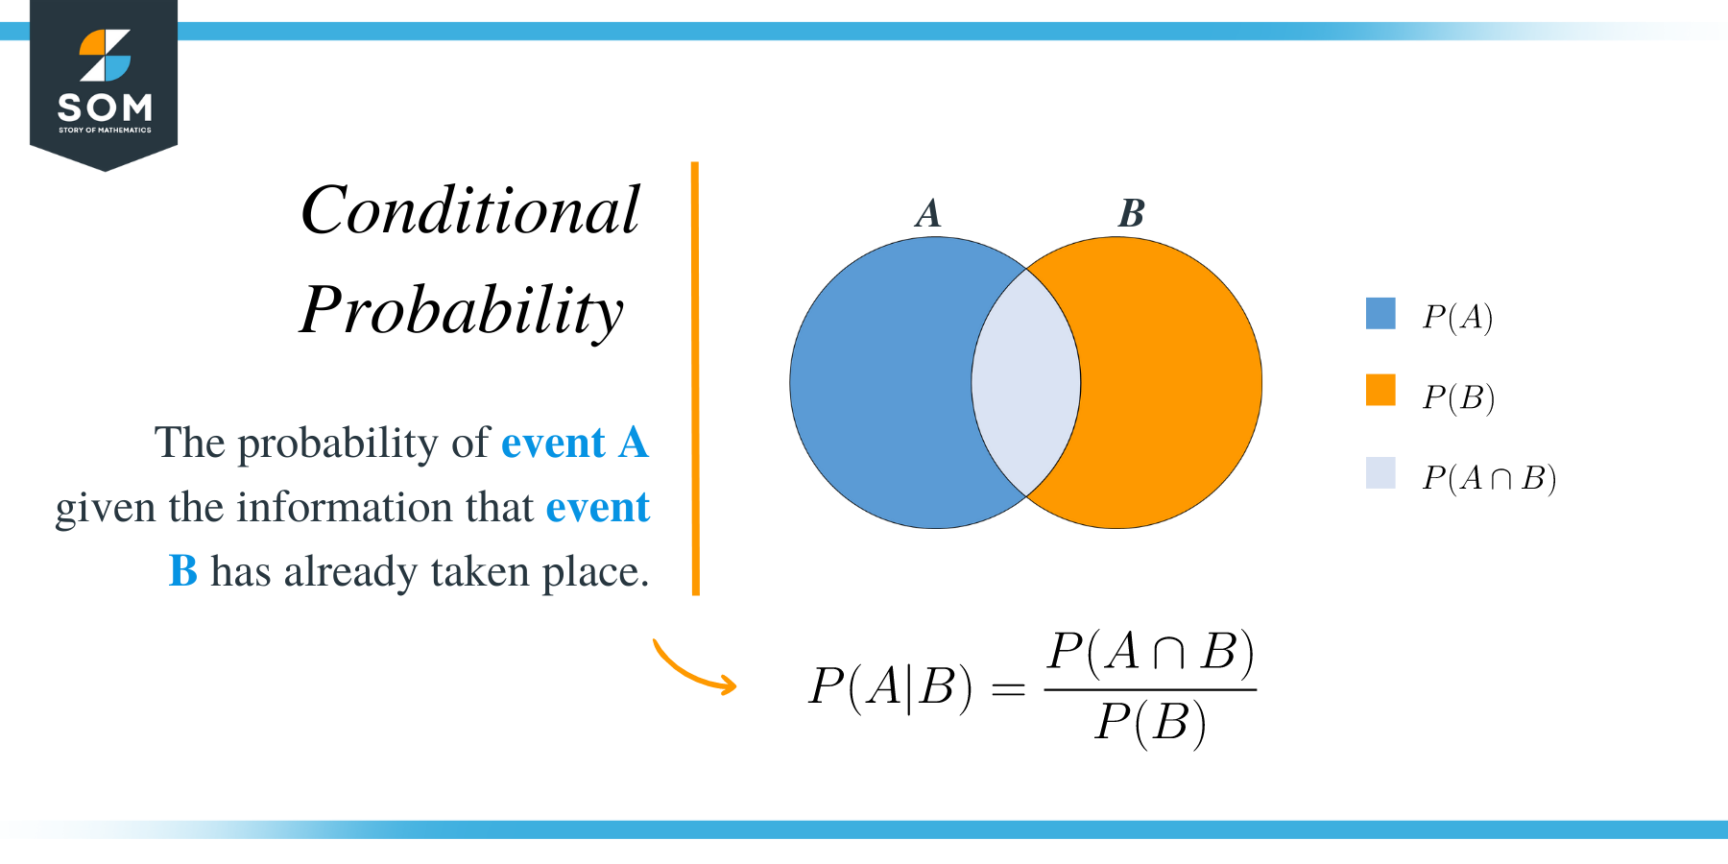
Conditional probability

Slide 6
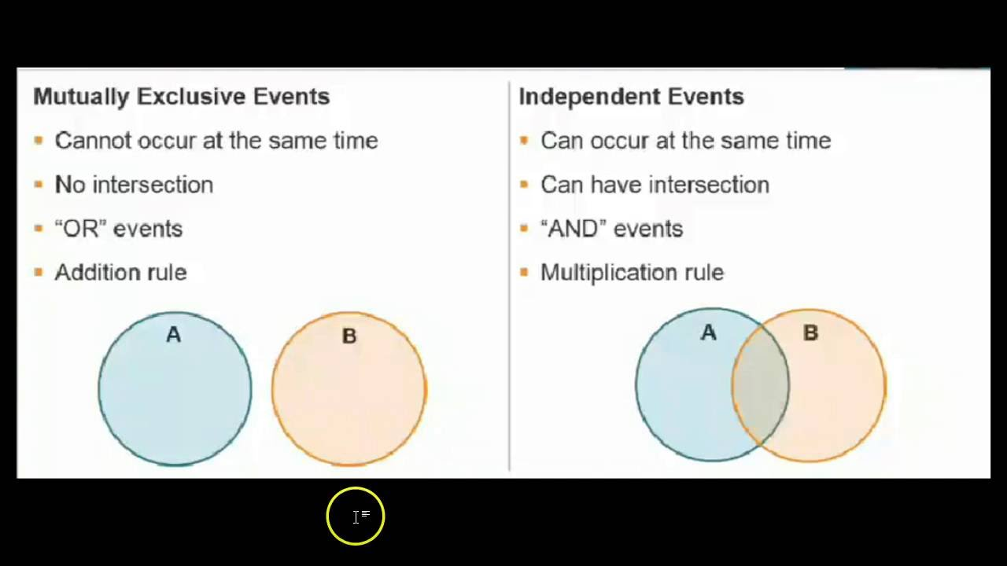
Independence

Slide 7
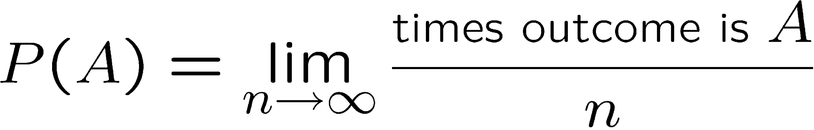
Interpretation of probability
I. Relative frequency
A, B, ... are outcomes of a repeatable experiment
cf. quantum mechanics, particle scattering, radioactive decay...
II. Subjective probability
A, B, ... are hypotheses (statements that are true or false)
• Both interpretations consistent with Kolmogorov axioms.
• In particle physics frequency interpretation often most useful,
but subjective probability can provide more natural treatment of
non-repeatable phenomena:
systematic uncertainties, probability that Higgs boson exists,...

Slide 8
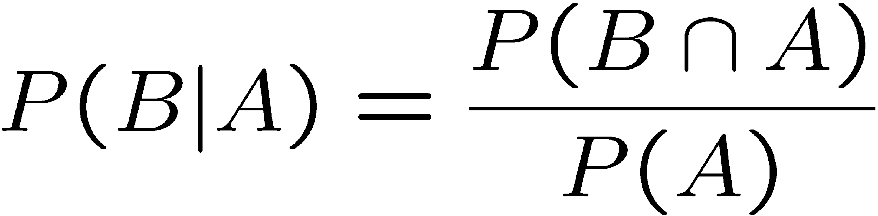
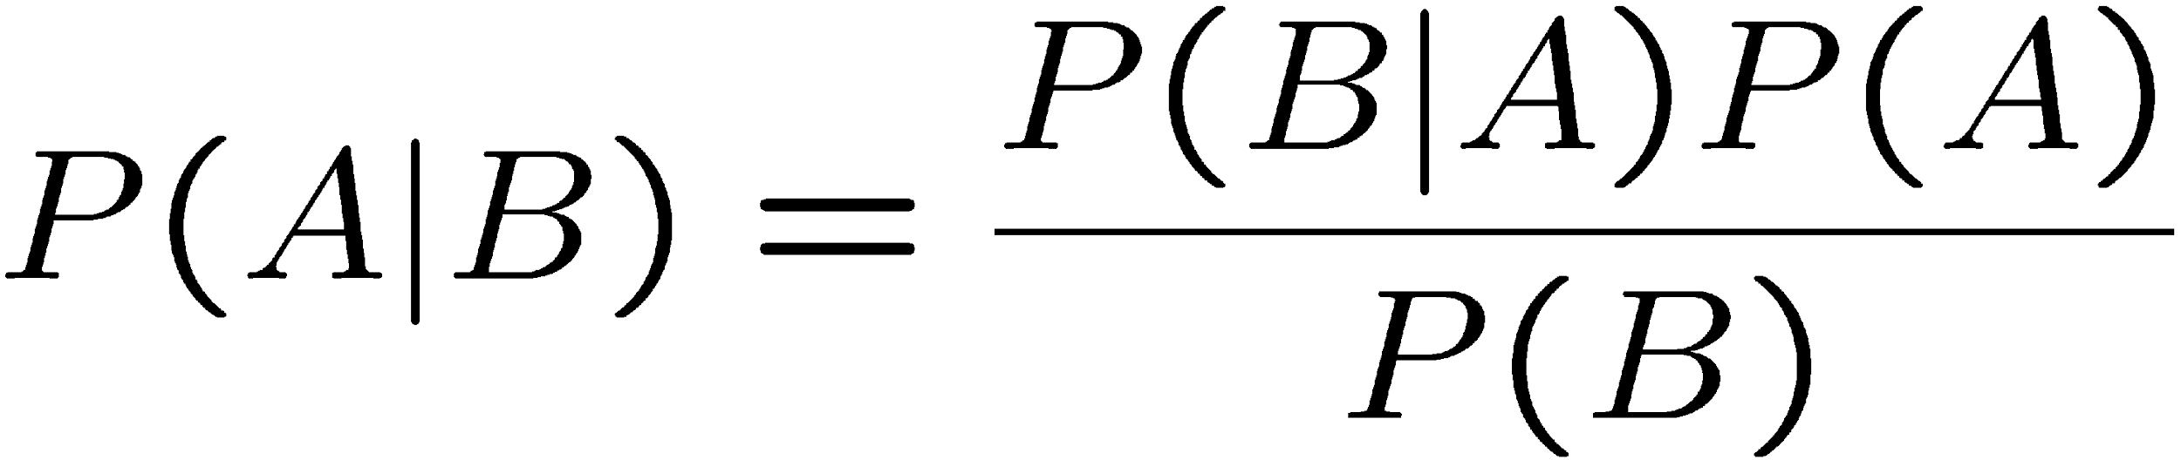
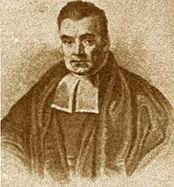
Bayes’ theorem
From the definition of conditional probability we have,
and
but
, so
Bayes’ theorem
First published (posthumously) by the
Reverend Thomas Bayes (1702−1761)
An essay towards solving a problem in the
doctrine of chances, Philos. Trans. R. Soc. 53
(1763) 370; reprinted in Biometrika, 45 (1958) 293.

Slide 9
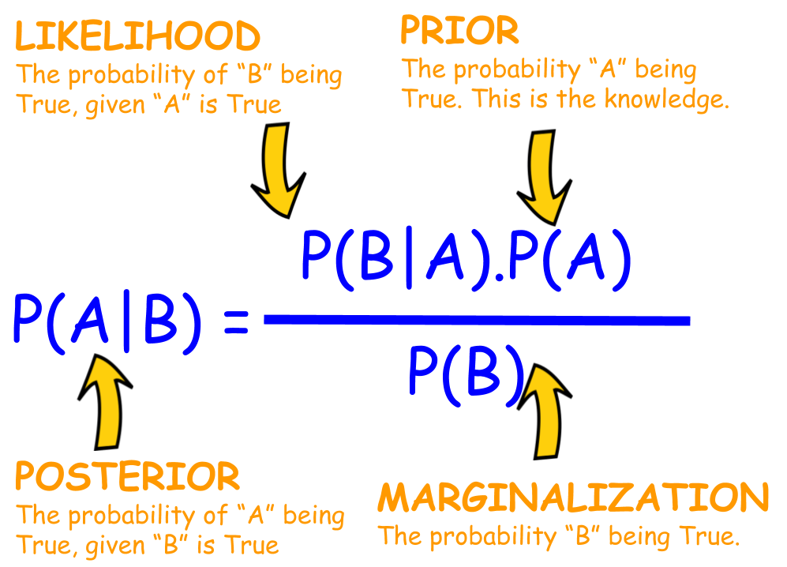
Bayes’ idea

Slide 10
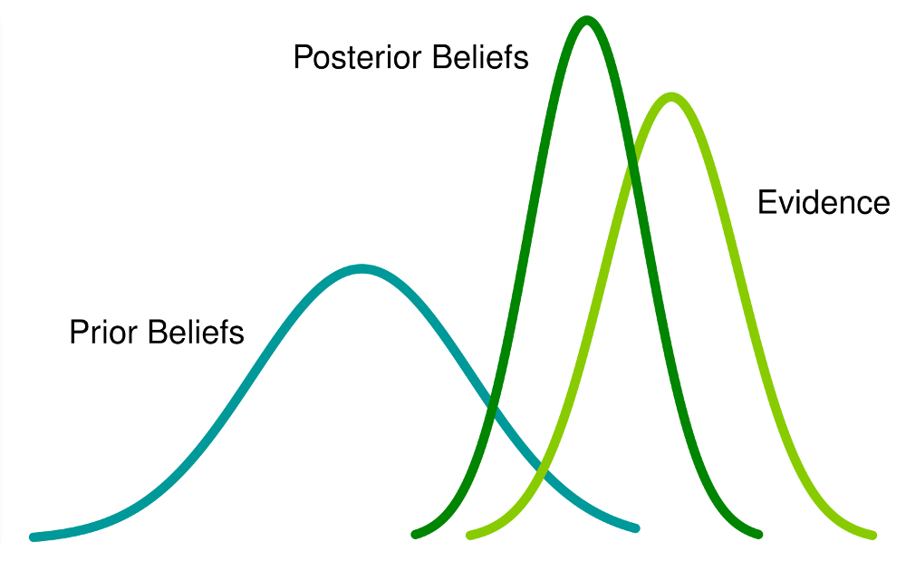
Bayes’idea illustration

Slide 11
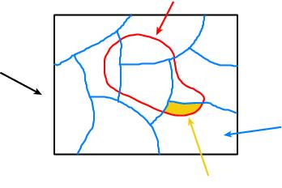
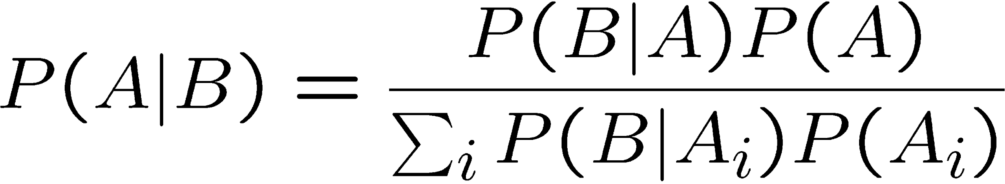
The law of total probability to Bayesian formulation
B
Consider a subset B of
the sample space S,
S
divided into disjoint subsets A_{i}
such that ∪_{i} A_{i} = S,
A_{i}
B ∩ A_{i}
→
→
→
law of total probability
Bayes’ theorem becomes

Slide 12
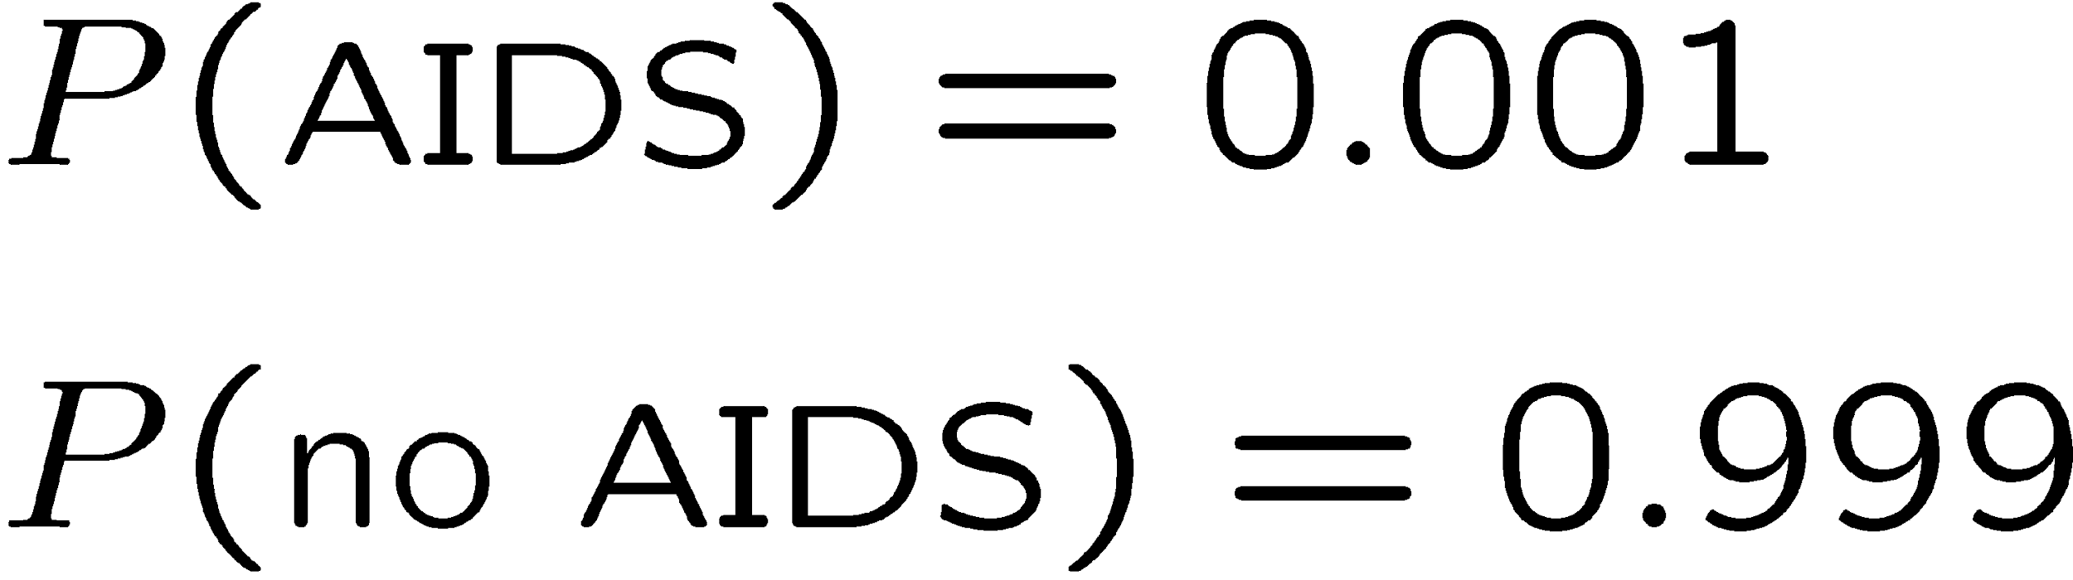
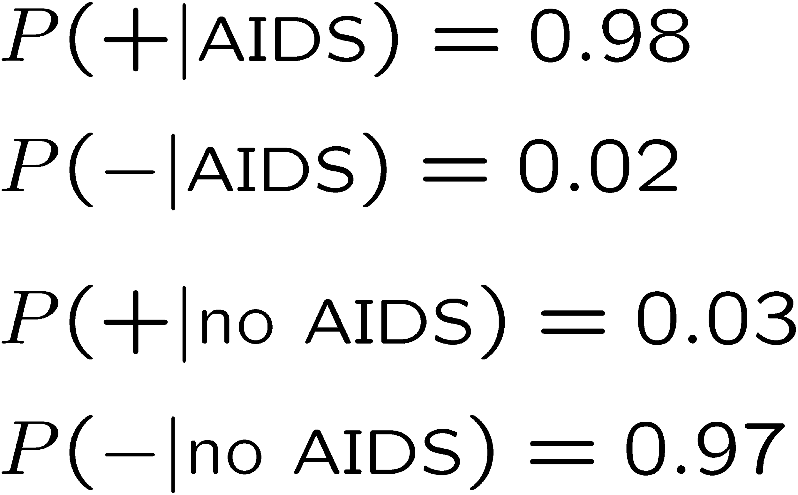
An example using Bayes’ theorem
Suppose the probability (for anyone) to have AIDS is:
← prior probabilities, i.e.,
before any test carried out
Consider an AIDS test: result is + or −
← probabilities to (in)correctly
identify an infected person
← probabilities to (in)correctly
identify an uninfected person
Suppose your result is +. How worried should you be?

Slide 13
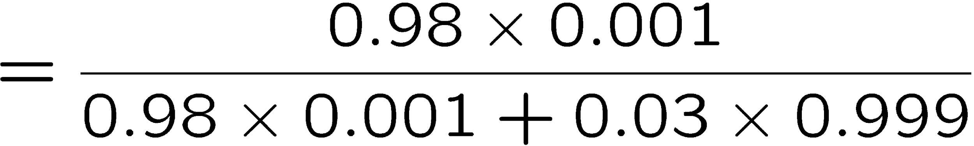

Bayes’ theorem example (cont.)
The probability to have AIDS given a + result is
← posterior probability
i.e. you’re probably OK!
Your viewpoint: my degree of belief that I have AIDS is 3.2%
Your doctor’s viewpoint: 3.2% of people like this will have AIDS

Slide 14

Frequentist Statistics − general philosophy
In frequentist statistics, probabilities are associated only with
the data, i.e., outcomes of repeatable observations (shorthand: ).
Probability = limiting frequency
Probabilities such as
P (AIDS exists),
P (0.117 < α_{s} < 0.121),
etc. are either 0 or 1, but we don’t know which.
The tools of frequentist statistics tell us what to expect, under
the assumption of certain probabilities, about hypothetical
repeated observations.
The preferred theories (models, hypotheses, ...) are those for which our observations would be considered ‘usual’.

Slide 15
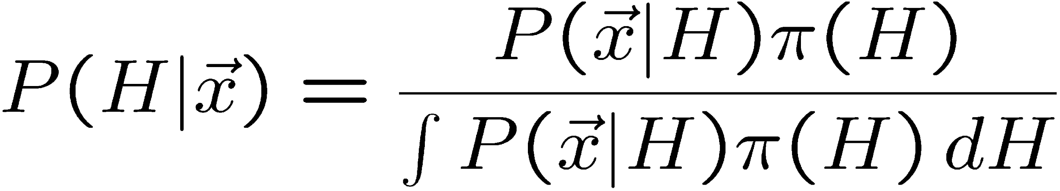
Bayesian Statistics − general philosophy
In Bayesian statistics, use subjective probability for hypotheses:
probability of the data assuming
hypothesis H (the likelihood)
prior probability, i.e.,
before seeing the data
posterior probability, i.e.,
after seeing the data
normalization involves sum
over all possible hypotheses
Bayes’ theorem has an “if-then” character: If your prior
probabilities were π (H), then it says how these probabilities
should change in the light of the data.
No general prescription for priors (subjective!)

Slide 16
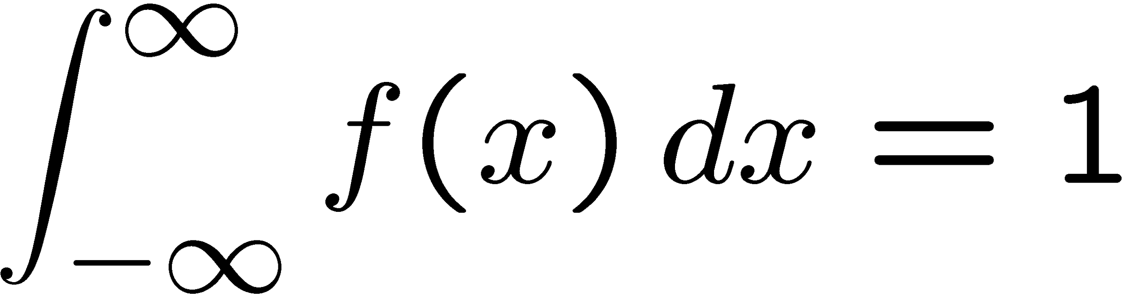

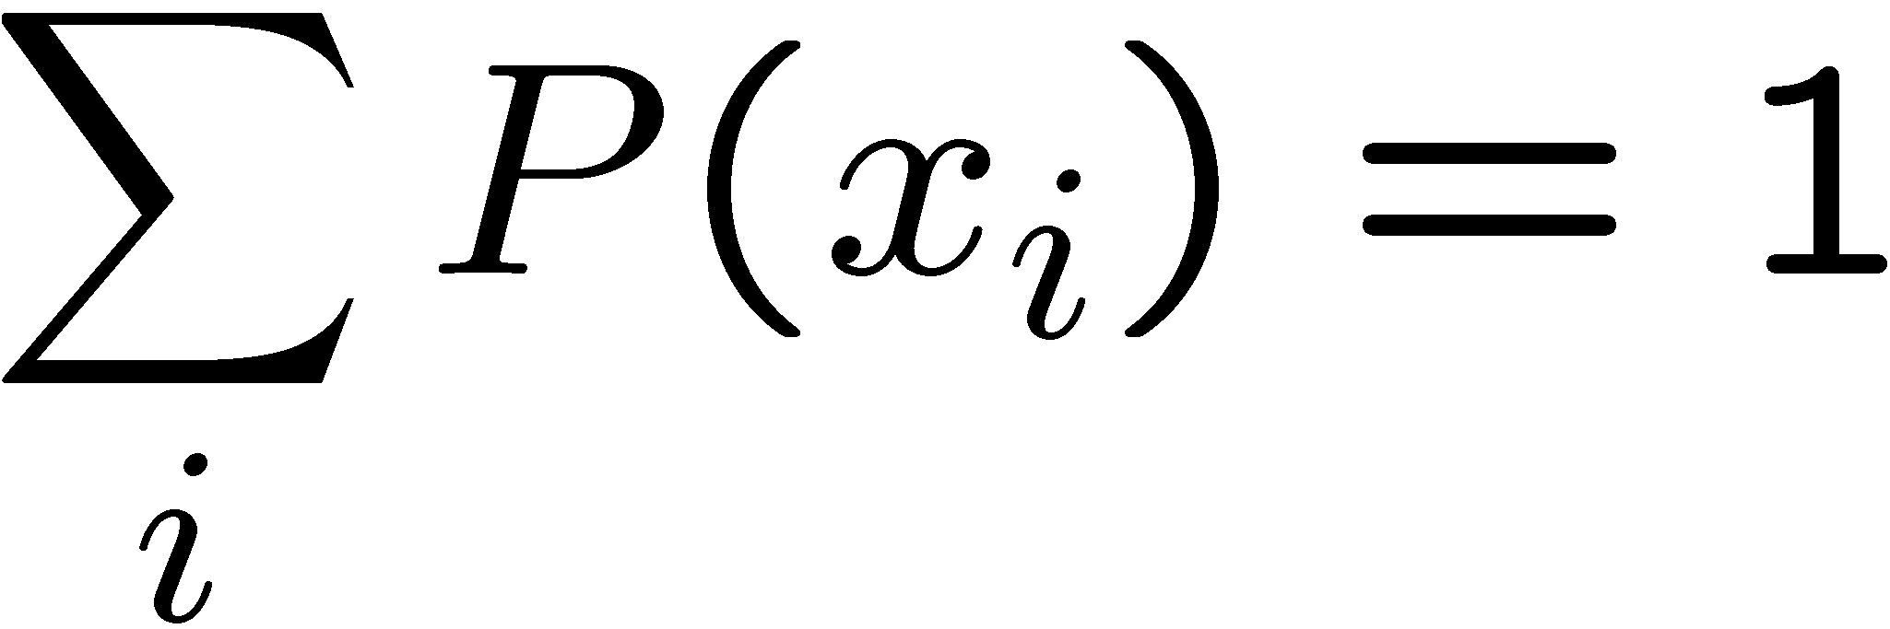
Random variables and probability density functions
A random variable is a numerical characteristic assigned to an element of the sample space; can be discrete or continuous.
Suppose outcome of experiment is continuous value x
→ f(x) = probability density function (pdf)
x must be somewhere
Or for discrete outcome x_{i} with e.g. i = 1, 2, ... we have
probability mass function
x must take on one of its possible values

Slide 17
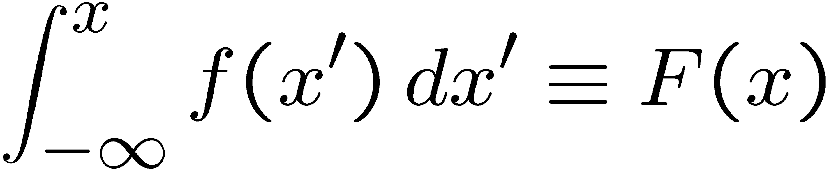
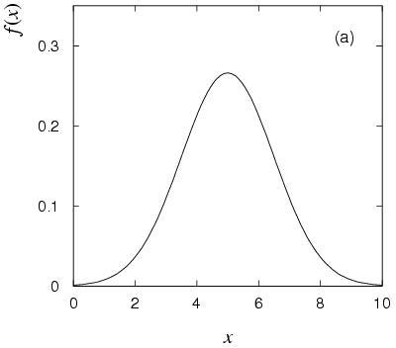
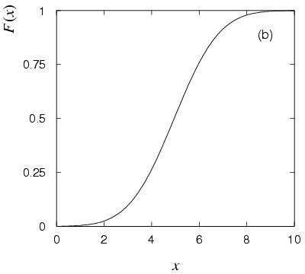
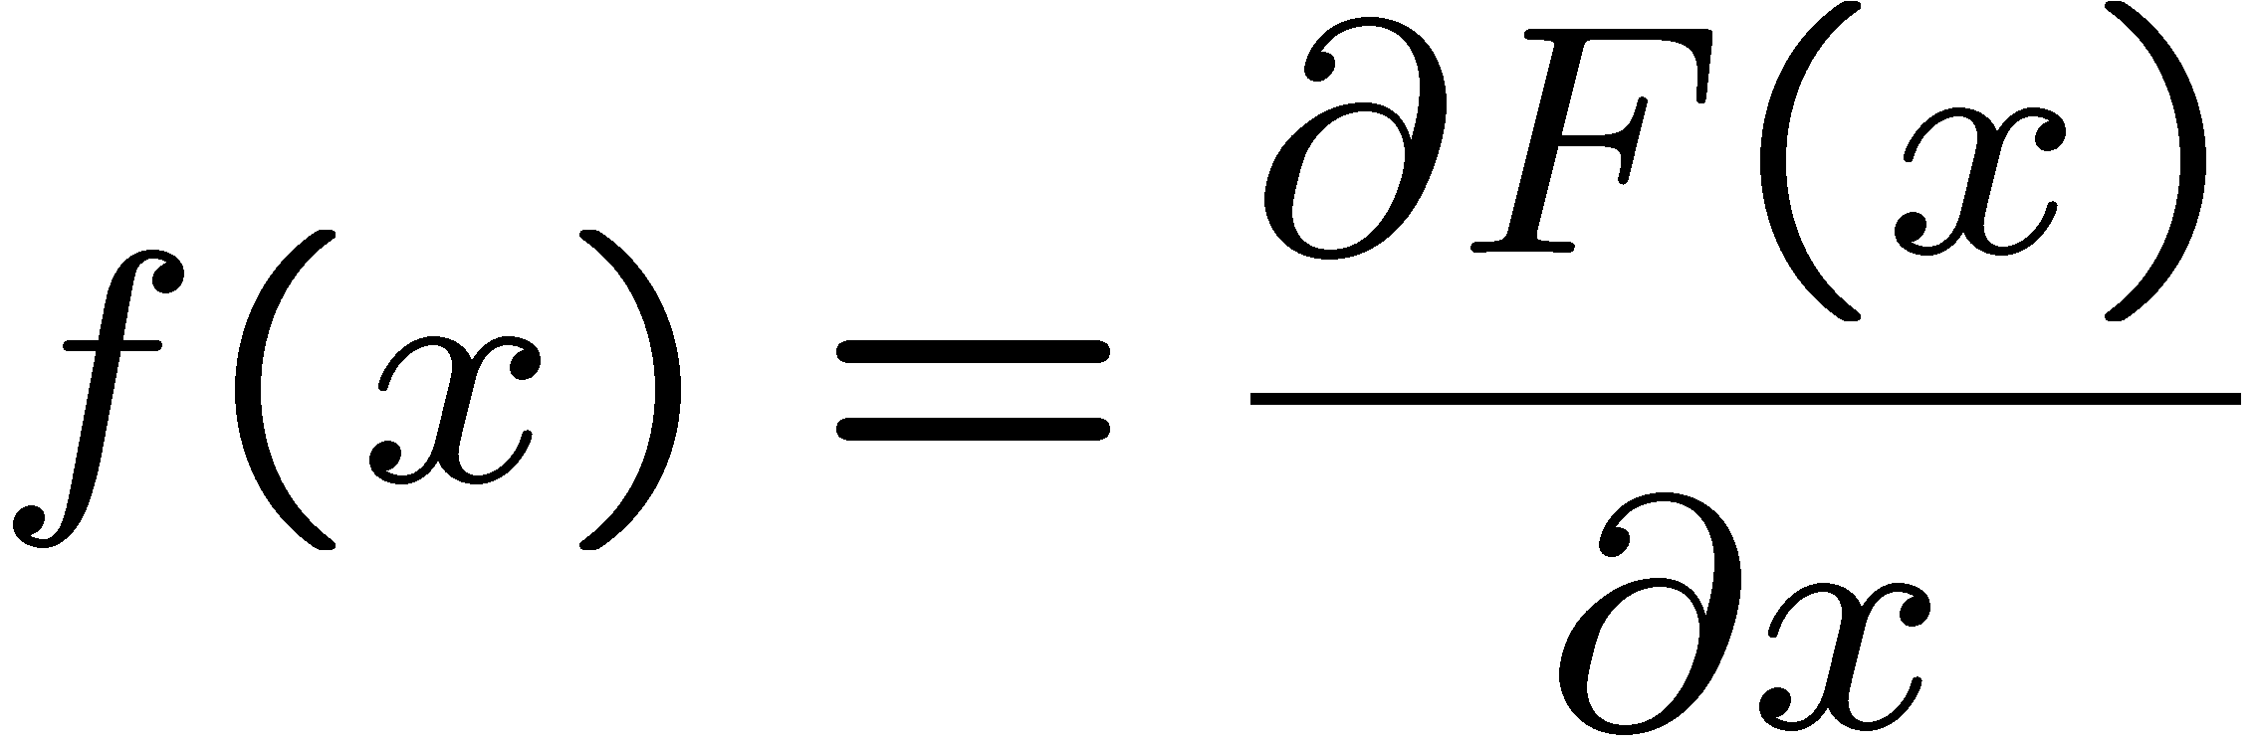
Cumulative distribution function
Probability to have outcome less than or equal to x is
cumulative distribution function
Alternatively define pdf with

Slide 18
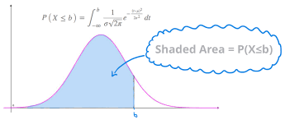

Slide 19
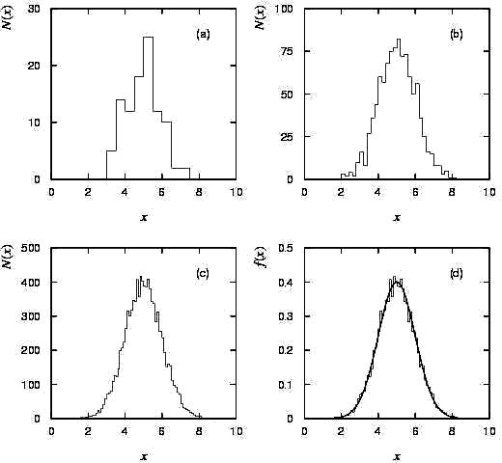
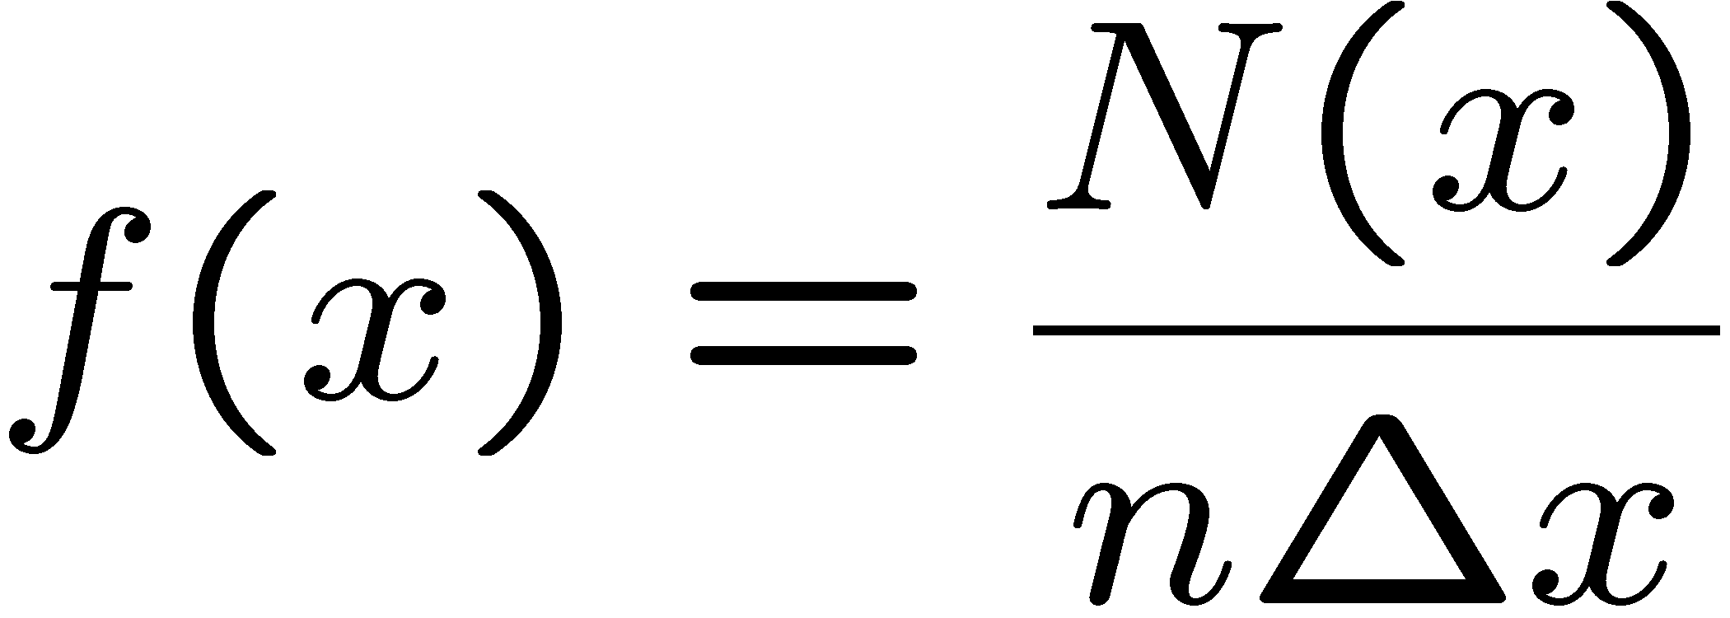

Histograms
pdf = histogram with
infinite data sample,
zero bin width,
normalized to unit area.

Slide 20
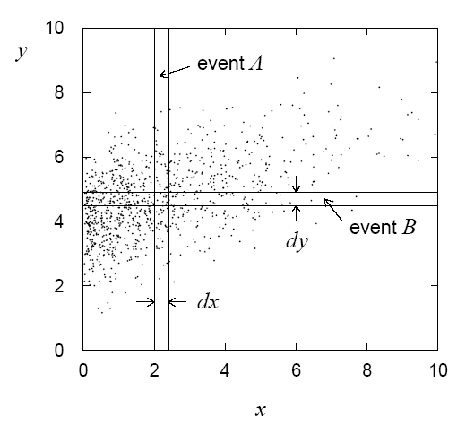
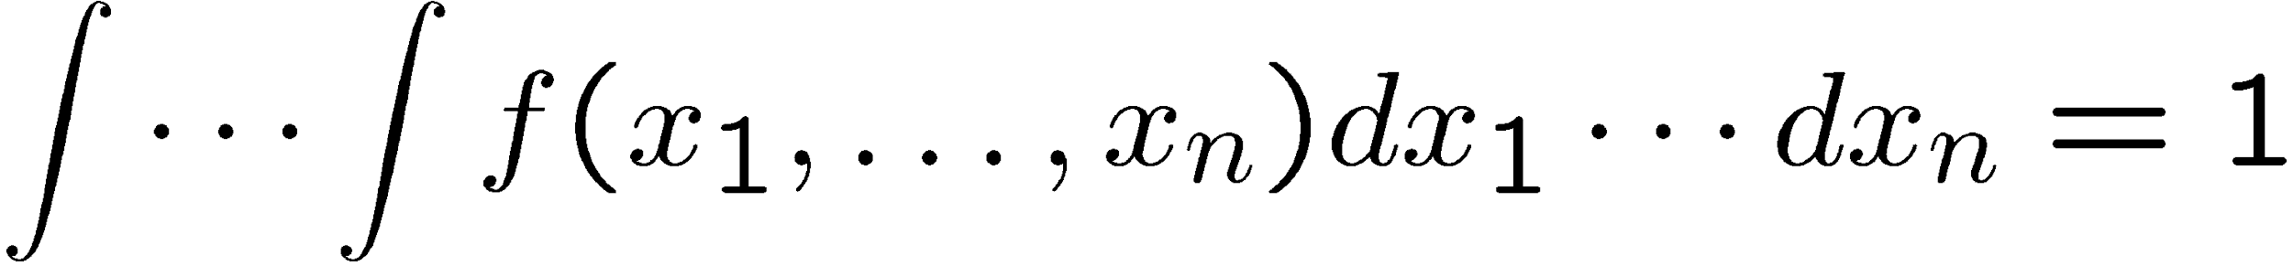
Multivariate distributions
Outcome of experiment charac-
terized by several values, e.g. an
n-component vector, (x₁, ... x_{n})
joint pdf
Normalization:

Slide 21
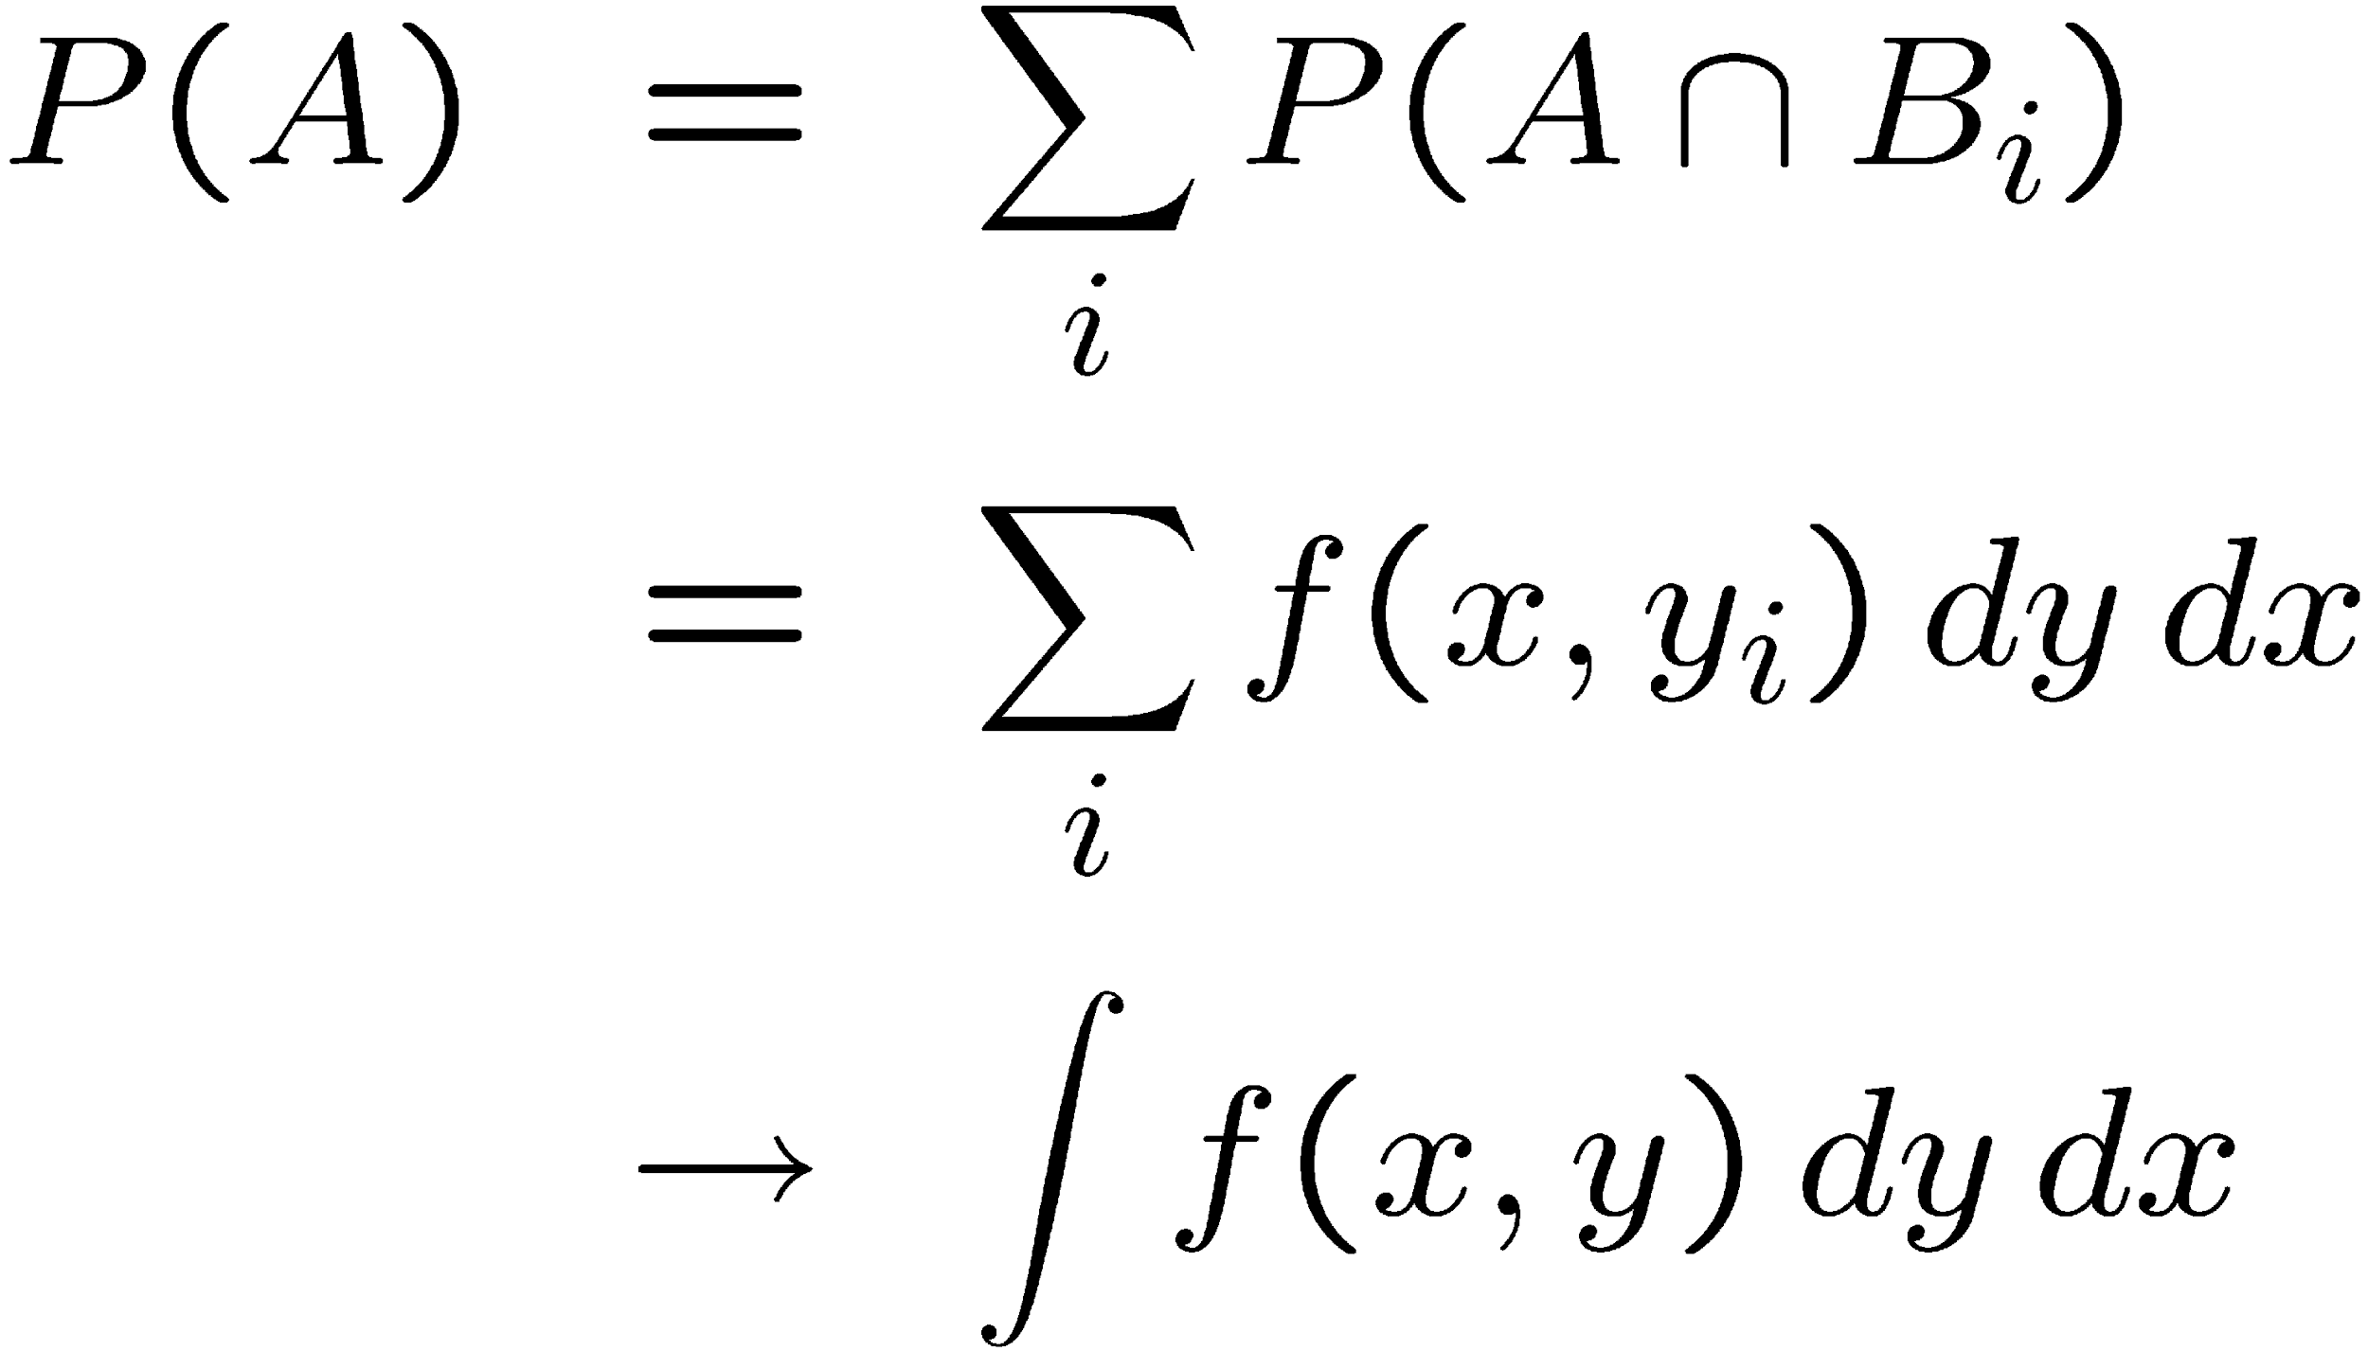
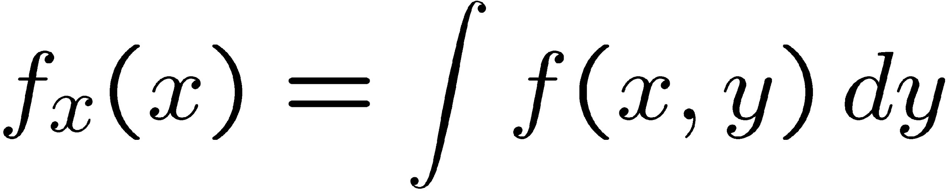
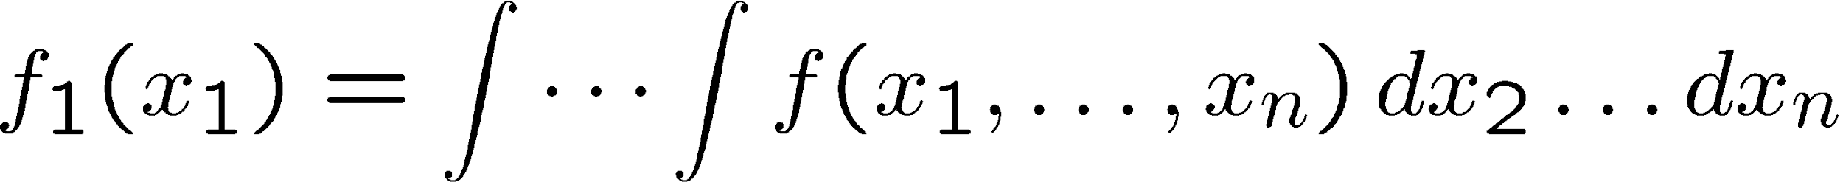
Marginal pdf
Sometimes we want only pdf of
some (or one) of the components:
i
→ marginal pdf
x₁, x₂ independent if

Slide 22
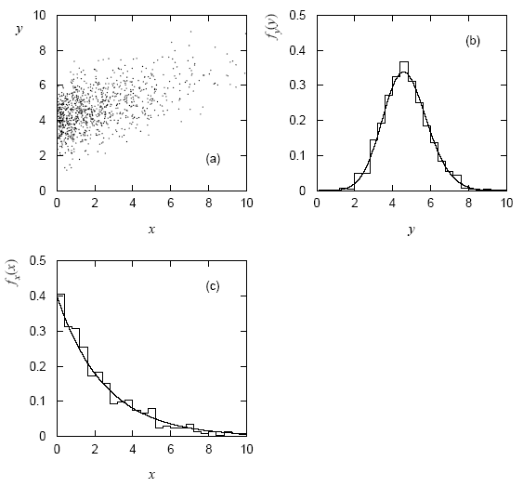
Marginal pdf (2)
Marginal pdf ~ projection of joint pdf onto individual axes.

Slide 23
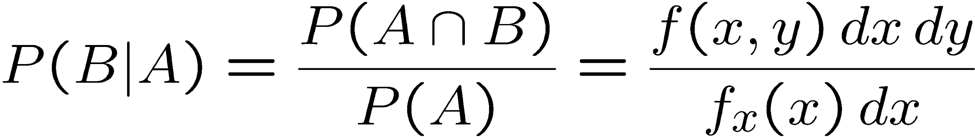
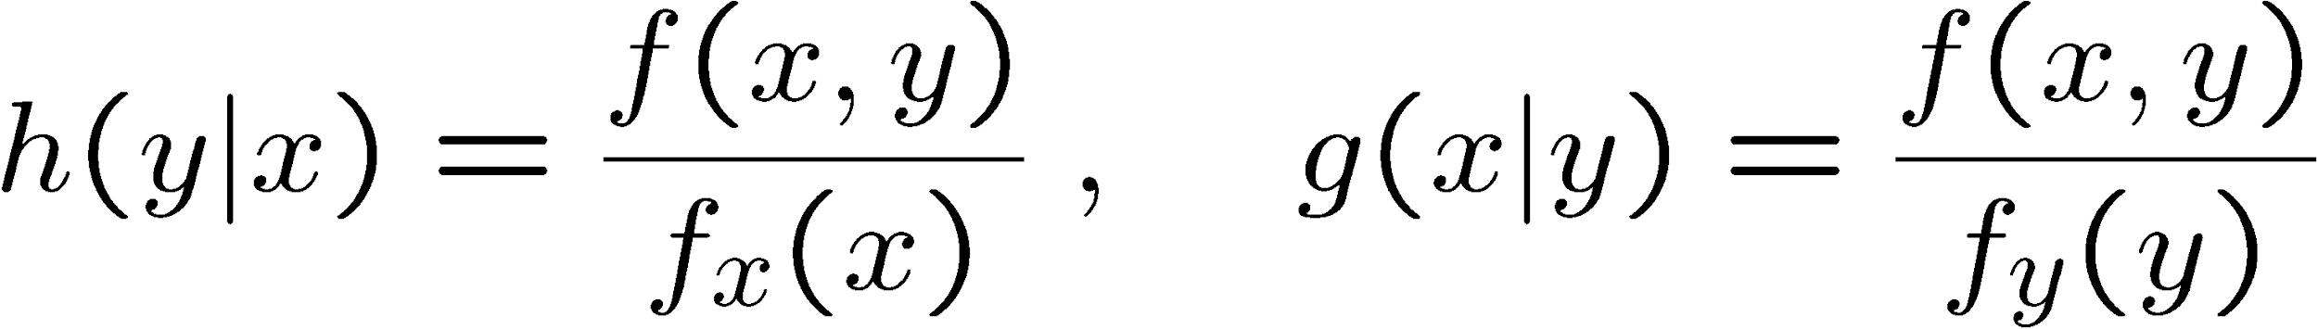
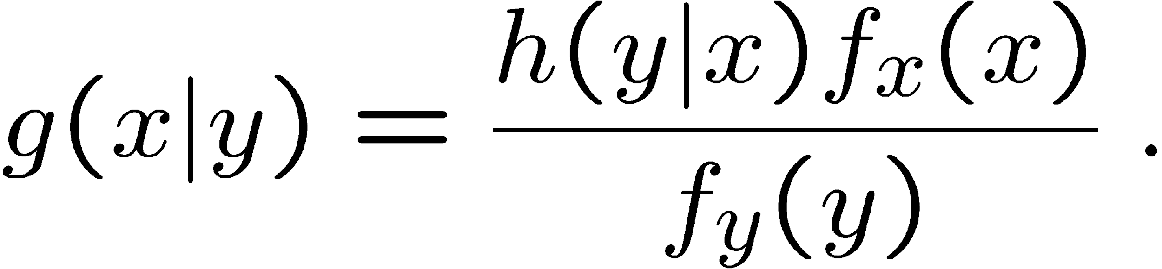

Conditional pdf
Sometimes we want to consider some components of joint pdf as constant. Recall conditional probability:
→ conditional pdfs:
Bayes’ theorem becomes:
Recall A, B independent if
→ x, y independent if

Slide 24
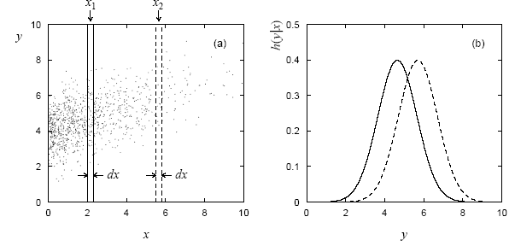
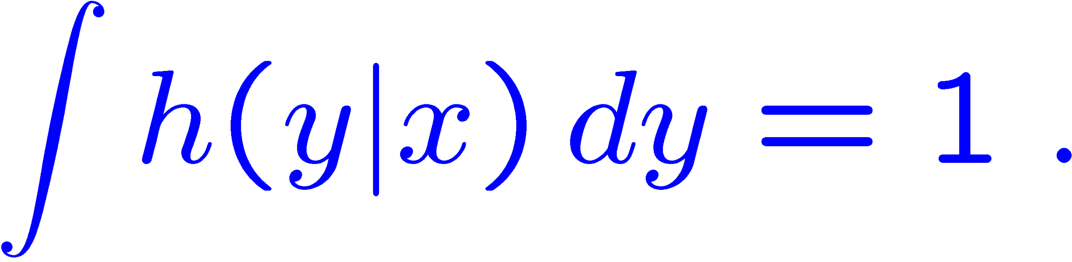
Conditional pdfs (2)
E.g. joint pdf f(x,y) used to find conditional pdfs h(y|x₁), h(y|x₂):
Basically treat some of the r.v.s as constant, then divide the joint
pdf by the marginal pdf of those variables being held constant so
that what is left has correct normalization, e.g.,

Slide 25
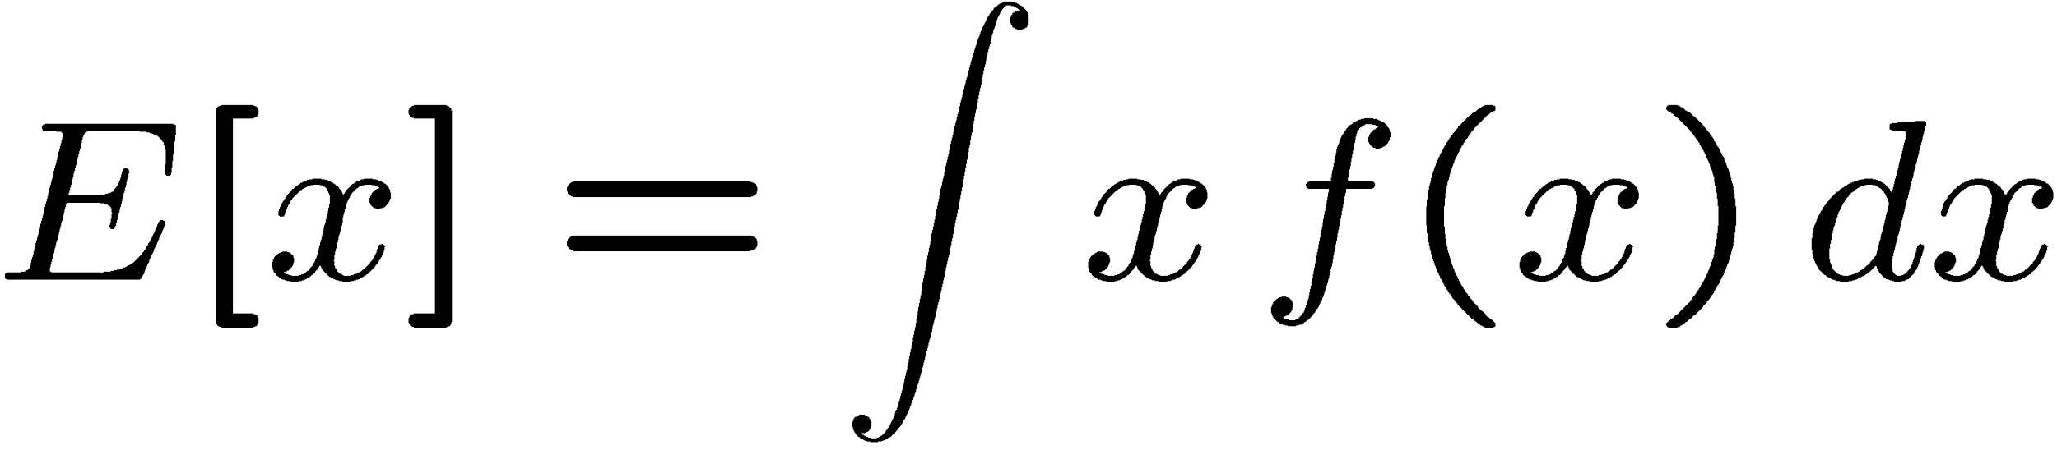

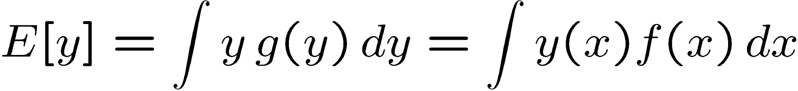
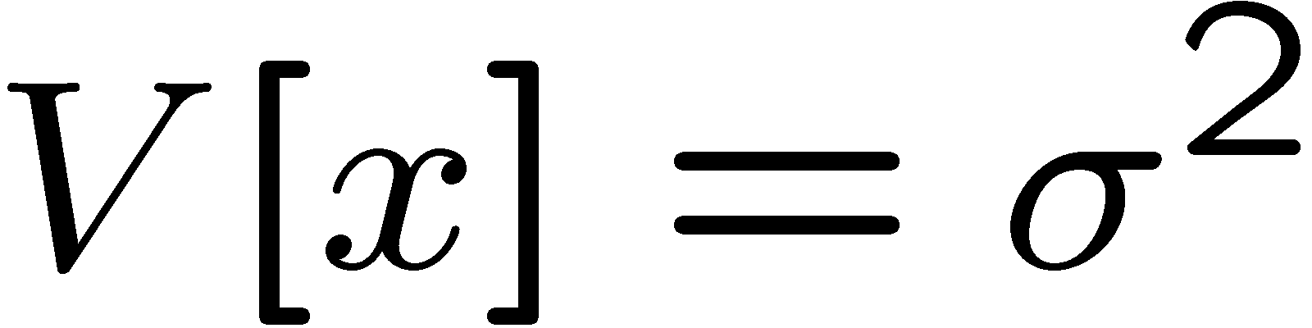
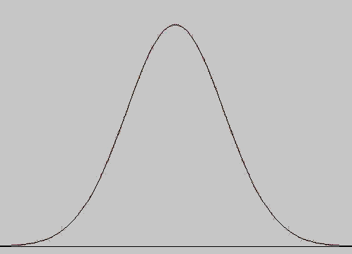
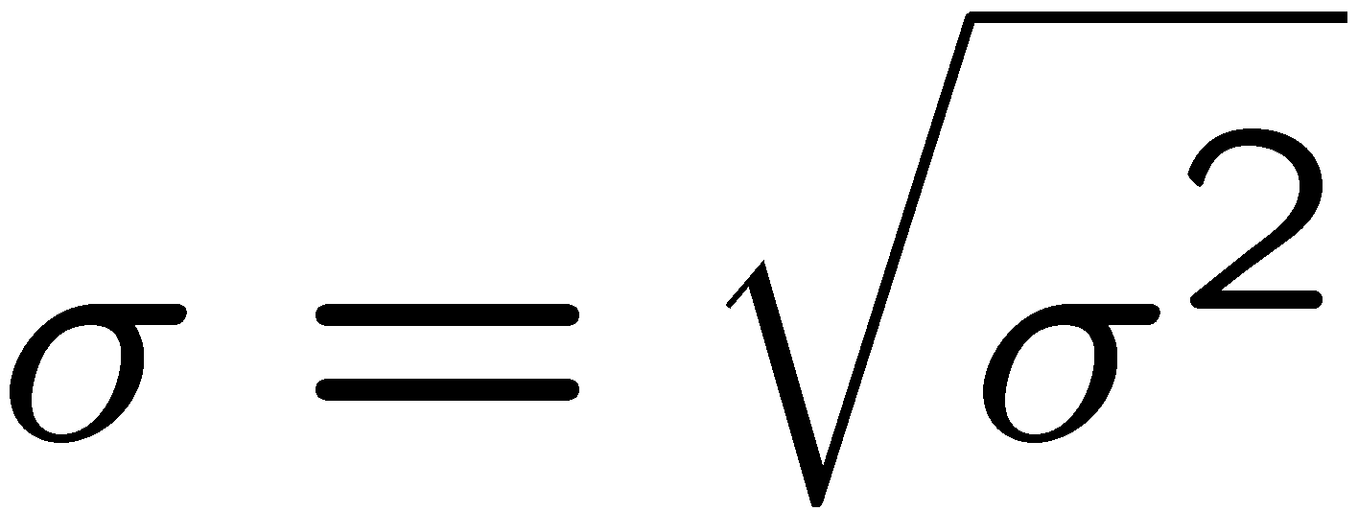


Expectation values
Consider continuous r.v. x with pdf f (x).
Define expectation (mean) value as
Notation (often): ~ “centre of gravity” of pdf.
For a function y(x) with pdf g(y),
(equivalent)
Variance:
Notation:
Standard deviation:
σ ~ width of pdf, same units as x.

Slide 26
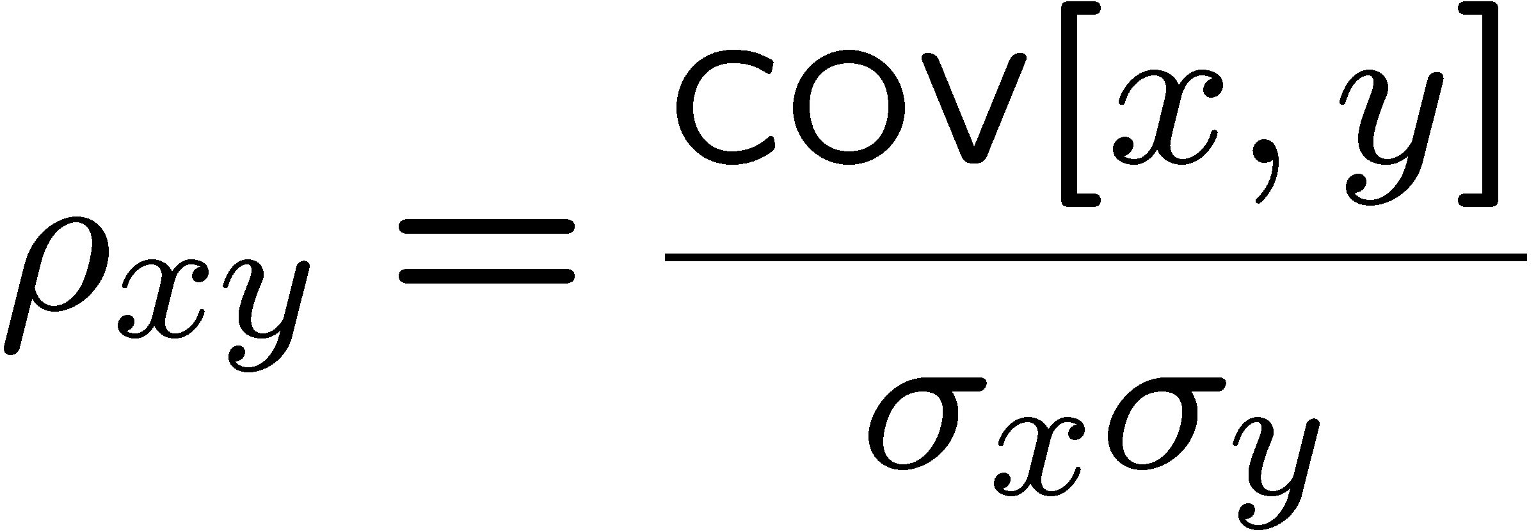
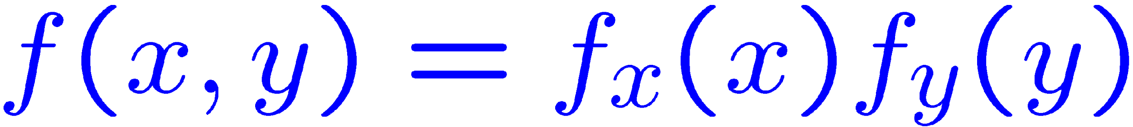
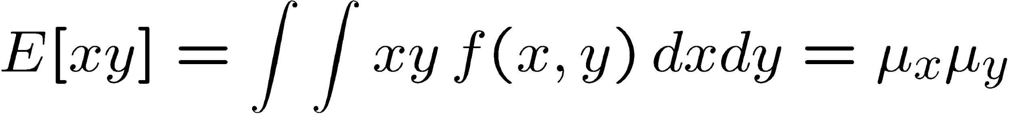

Covariance and correlation
Define covariance cov[x,y] (also use matrix notation V_{xy}) as
Correlation coefficient (dimensionless) defined as
If x, y, independent, i.e.,
, then
→
x and y, ‘uncorrelated’
N.B. converse not always true.

Slide 27
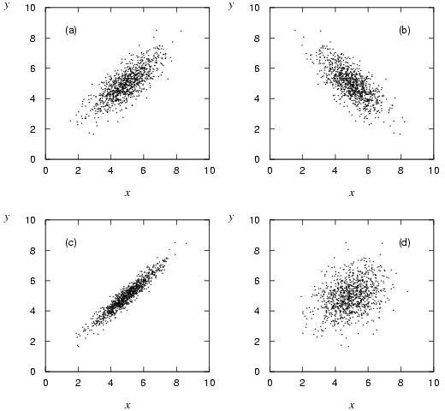
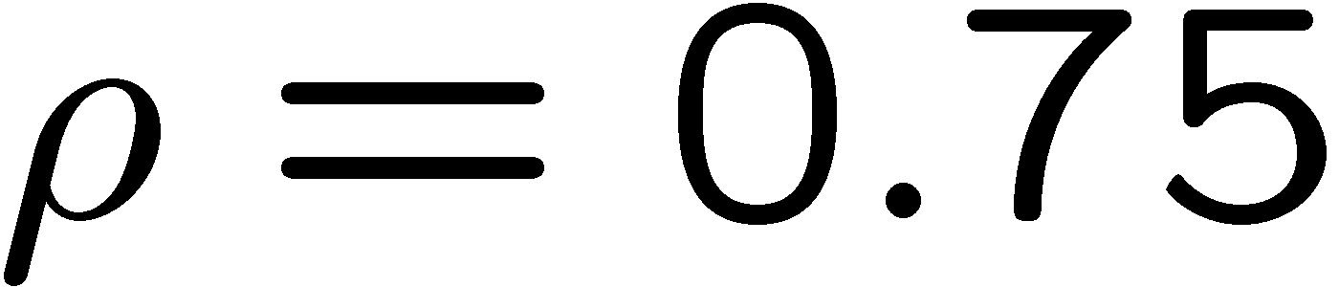
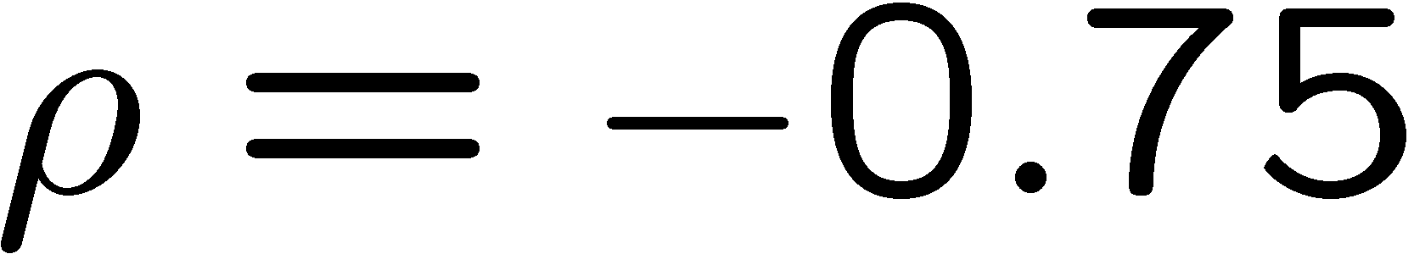
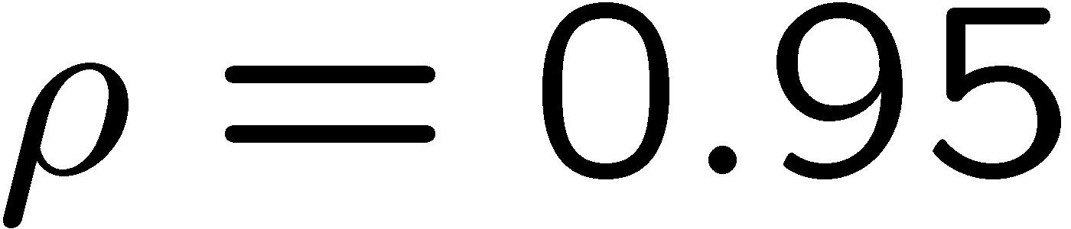

Correlation (cont.)

Slide 28
Some distributions
Distribution/pdf
Binomial
Multinomial
Uniform
Gaussian

Slide 29

Binomial distribution
Consider N independent experiments (Bernoulli trials):
outcome of each is ‘success’ or ‘failure’,
probability of success on any given trial is p.
Define discrete r.v. n = number of successes (0 ≤ n ≤ N).
Probability of a specific outcome (in order), e.g. ‘ssfsf’ is
But order not important; there are
ways (permutations) to get n successes in N trials, total
probability for n is sum of probabilities for each permutation.

Slide 30


Binomial distribution (2)
The binomial distribution is therefore
random
variable
parameters
For the expectation value and variance we find:

Slide 31


Binomial distribution (3)
Binomial distribution for several values of the parameters:
Example: observe N decays of W±, the number n of which are
W→μν is a binomial r.v., p = branching ratio.

Slide 32



Multinomial distribution
Like binomial but now m outcomes instead of two, probabilities are
For N trials we want the probability to obtain:
n₁ of outcome 1,
n₂ of outcome 2,
…
n_{m} of outcome m.
This is the multinomial distribution for

Slide 33

Multinomial distribution (2)
Now consider outcome i as ‘success’, all others as ‘failure’.
→ all n_{i} individually binomial with parameters N, p_{i}
for all i
One can also find the covariance to be
Example:
represents a histogram
with m bins, N total entries, all entries independent.

Slide 34




Uniform distribution
Consider a continuous r.v. x with −∞ < x < ∞ . Uniform pdf is:
N.B. For any r.v. x with cumulative distribution F(x),
y = F(x) is uniform in [0,1].
Example: for π⁰ → γγ, E_{γ} is uniform in [E_{min}, E_{max}], with

Slide 35





Gaussian distribution
The Gaussian (normal) pdf for a continuous r.v. x is defined by:
(N.B. often μ, σ² denote
mean, variance of any
r.v., not only Gaussian.)
Special case: μ = 0, σ² = 1 (‘standard Gaussian’):
If y ~ Gaussian with μ, σ², then x = (y − μ) /σ follows ϕ (x).

Slide 36



Gaussian pdf and the Central Limit Theorem
The Gaussian pdf is so useful because almost any random
variable that is a sum of a large number of small contributions
follows it. This follows from the Central Limit Theorem:
For n independent r.v.s x_{i} with finite variances σ_{i}², otherwise
arbitrary pdfs, consider the sum
In the limit n → ∞, y is a Gaussian r.v. with
Measurement errors are often the sum of many contributions, so frequently measured values can be treated as Gaussian r.v.s.

Slide 37




Multivariate Gaussian distribution
Multivariate Gaussian pdf for the vector
are column vectors,
are transpose (row) vectors,
For n = 2 this is
where ρ = cov[x₁, x₂]/(σ₁σ₂) is the correlation coefficient.

Slide 38


Univariate Normal Distribution

Slide 39


Multivariate Normal Distribution

Slide 40

Random Sample and Statistics
Population: is used to refer to the set or universe of all entities under study.
However, looking at the entire population may not be feasible, or may be too expensive.
Instead, we draw a random sample from the population, and compute appropriate statistics from the sample, that give estimates of the corresponding population parameters of interest.

Slide 41
Statistic
Let Si denote the random variable corresponding to data point xi , then a statistic ˆθ is a function ˆθ : (S1, S2, · · · , Sn) → R.
If we use the value of a statistic to estimate a population parameter, this value is called a point estimate of the parameter, and the statistic is called as an estimator of the parameter.

Slide 42


Empirical Cumulative Distribution Function
Where
Inverse Cumulative Distribution Function

Slide 43



Example

Slide 44




Measures of Central Tendency (Mean)
Population Mean:
Sample Mean (Unbiased, not robust):

Slide 45



Measures of Central Tendency (Median)
Population Median:
or
Sample Median:

Slide 46
Example

Slide 47


Measures of Dispersion (Range)
Range:
Sample Range:
Not robust, sensitive to extreme values

Slide 48




Measures of Dispersion (Inter-Quartile Range)
Inter-Quartile Range (IQR):
Sample IQR:
More robust

Slide 49



Measures of Dispersion
(Variance and Standard Deviation)
Variance:
Standard Deviation:

Slide 50

Measures of Dispersion
(Variance and Standard Deviation)
Variance:
Standard Deviation:
Sample Variance & Standard Deviation:

Slide 51
EDA and Visualization
Exploratory Data Analysis (EDA) and Visualization are important (necessary?) steps in any analysis task.
get to know your data!
  distributions (symmetric, normal, skewed)
  data quality problems
  outliers
  correlations and inter-relationships
  subsets of interest
  suggest functional relationships
Sometimes EDA or viz might be the goal!

Slide 52

flowingdata.com 9/9/11

Slide 53

NYTimes 7/26/11

Slide 54

Exploratory Data Analysis (EDA)
Goal: get a general sense of the data
  means, medians, quantiles, histograms, boxplots
  You should always look at every variable - you will learn something!
data-driven (model-free)
Think interactive and visual
  Humans are the best pattern recognizers
  You can use more than 2 dimensions!
    x,y,z, space, color, time….
especially useful in early stages of data mining
  detect outliers (e.g. assess data quality)
  test assumptions (e.g. normal distributions or skewed?)
  identify useful raw data & transforms (e.g. log(x))
Bottom line: it is always well worth looking at your data!

Slide 55

EDA lifecycle

Slide 56

Why it's useful for Big Data Analytics
Notes:
Because we cannot see the population of big data.

Slide 57
Summary Statistics
not visual
sample statistics of data X
  mean: μ = ∑_{i} X_{i} / n
  mode: most common value in X
  median: X=sort(X), median = X_{n/2} (half below, half above)
  quartiles of sorted X: Q1 value = X_{0.25n} , Q3 value = X_{0.75 n}
    interquartile range: value(Q3) - value(Q1)
    range: max(X) - min(X) = X_{n} - X₁
  variance: σ² = ∑_{i} (X_{i} - μ)² / n
  skewness: ∑_{i} (X_{i} - μ)³ / [ (∑_{i} (X_{i} - μ)²)^{3/2} ]
    zero if symmetric; right-skewed more common (what kind of data is right skewed?)
  number of distinct values for a variable (see unique() in R)
  Don’t need to report all of thses: Bottom line…do these numbers make sense???

Slide 58



Single Variable Visualization
Histogram:
  Shows center, variability, skewness, modality,
  outliers, or strange patterns.
  Bins matter
  Beware of real zeros

Slide 59
Issues with Histograms
For small data sets, histograms can be misleading.
  Small changes in the data, bins, or anchor can deceive
For large data sets, histograms can be quite effective at illustrating general properties of the distribution.
Histograms effectively only work with 1 variable at a time
  But ‘small multiples’ can be effective

Slide 60

But be careful with axes and scales!

Slide 61

Smoothed Histograms - Density Estimates
Kernel estimates smooth out the contribution of each datapoint over a local neighborhood of that point.
h is the kernel width
Gaussian kernel is common:

Slide 62

Bandwidth choice is an art
Usually want to try several

Slide 63

Boxplots
Shows a lot of information about a variable in one plot
  Median
  IQR
  Outliers
  Range
  Skewness
Negatives
  Overplotting
  Hard to tell distributional shape
  no standard implementation in software (many options for whiskers, outliers)

Slide 64
Time Series
If your data has a temporal component, be sure to exploit it
summer bifurcations in air travel
(favor early/late)
summer
peaks
steady growth
trend
New Year bumps

Slide 65

Spatial Data
If your data has a geographic component, be sure to exploit it
Data from cities/states/zip cods – easy to get lat/long
Can plot as scatterplot

Slide 66

Spatio-temporal data
spatio-temporal data
  http://projects.flowingdata.com/walmart/ (Nathan Yau)
  But, fancy tools not needed! Just do successive scatterplots to (almost) the same effect

Slide 67

Spatial data: choropleth Maps
Maps using color shadings to represent numerical values are called chloropleth maps
http://elections.nytimes.com/2008/results/president/map.html

Slide 68

Two Continuous Variables
For two numeric variables, the scatterplot is the obvious choice
interesting?
interesting?

Slide 69
2D Scatterplots
useful to answer:
  x,y related?
    linear
    quadratic
    other
  variance(y) depend on x?
  outliers present?
standard tool to display relation between 2 variables
  e.g. y-axis = response, x-axis = suspected indicator
interesting?
interesting?

Slide 70

Scatter Plot: No apparent relationship

Slide 71

Scatter Plot: Linear relationship

Slide 72

Scatter Plot: Quadratic relationship

Slide 73

Scatter plot: Homoscedastic
Why is this important in classical statistical modelling?

Slide 74

Scatter plot: Heteroscedastic
variation in Y differs depending on the value of X
e.g., Y = annual tax paid, X = income

Slide 75

Two variables - continuous
Scatterplots
  But can be bad with lots of data

Slide 76

Two variables - continuous
What to do for large data sets
  Contour plots

Slide 77




Two Variables - one categorical
Side by side boxplots are very effective in showing differences in a quantitative variable across factor levels
  tips data
    do men or women tip better
  orchard sprays
    measuring potency of various orchard sprays in repelling honeybees

Slide 78



Barcharts and Spineplots
stacked barcharts can be used to compare continuous values across two or more categorical ones.
spineplots show proportions well, but can be hard to interpret
orange=M blue=F

Slide 79

More than two variables
Pairwise scatterplots
Can be somewhat ineffective for categorical data

Slide 80


Slide 81

Networks and Graphs
Visualizing networks is helpful, even if is not obvious that a network exists

Slide 82


Network Visualization
Graphviz (open source software) is a nice layout tool for big and small graphs

Slide 83



What’s missing?
pie charts
  very popular
  good for showing simple relations of proportions
  Human perception not good at comparing arcs
  barplots, histograms usually better (but less pretty)
3D
  nice to be able to show three dimensions
  hard to do well
  often done poorly
  3d best shown through “spinning” in 2D
    uses various types of projecting into 2D
    http://www.stat.tamu.edu/~west/bradley/

Slide 84
Dimension Reduction
One way to visualize high dimensional data is to reduce it to 2 or 3 dimensions
  Variable selection
    e.g. stepwise
  Principle Components
    find linear projection onto p-space with maximal variance
  Multi-dimensional scaling
    takes a matrix of (dis)similarities and embeds the points in p-dimensional space to retain those similarities

Slide 85

An Illustration

